Slide 1

Delivato SECURITY BUSINESS PLAN

Slide 2
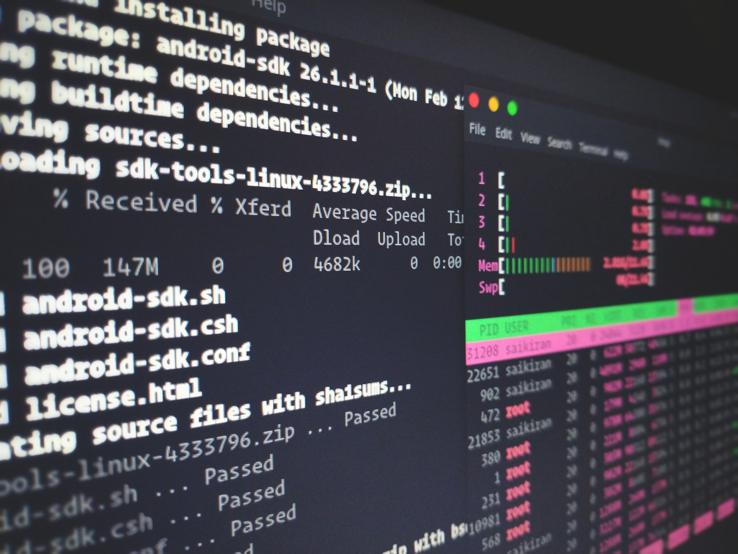
incorrect configuration

Slide 3

Firewall

Slide 4
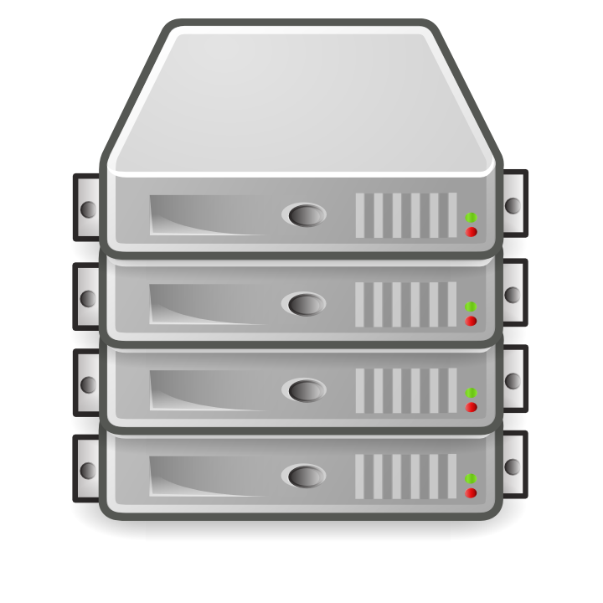
servers

Slide 5

Office devices

Slide 6
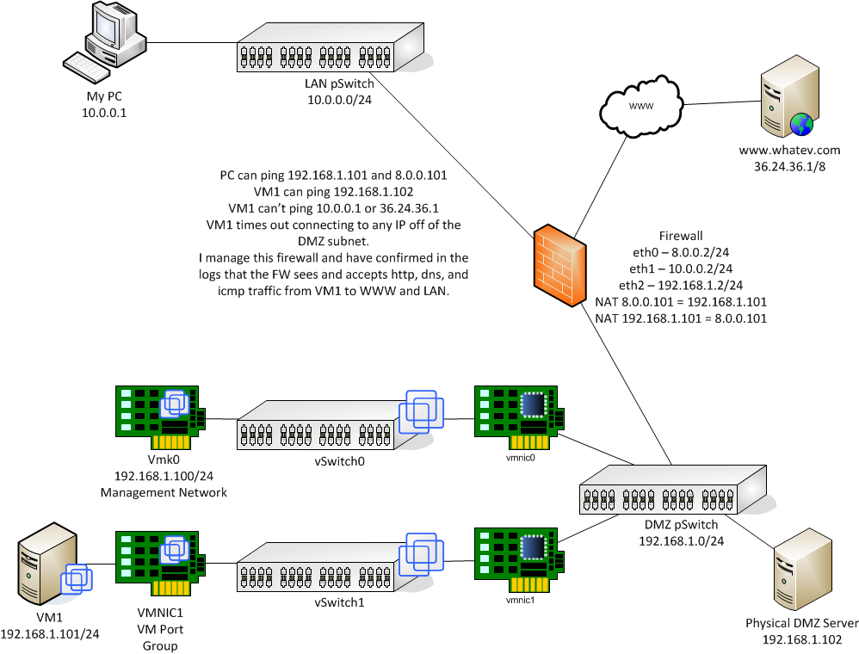

Slide 7
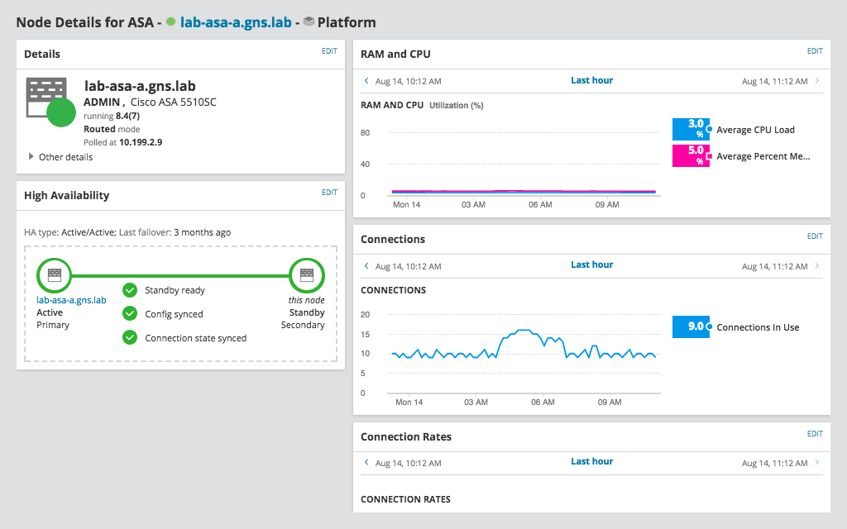
NMS (Network Monitoring System)
SolarWinds
Our platform enables optimal visibility, expertise and design to streamline, streamline and optimize repair time in a variety of settings and environments.

Slide 8
A
Entrance Security
Physical
B
UPS (Uninterruptible Power Supply)
Delivato
C
CCTV
D
password policy
Software
D
VPN
D
VLANs

Slide 9


